Slide 1
BUILDING TRUST AND ENGAGEMENT - CUSTOMER MAIL AND CITIZENS
May 2022

Slide 2
Trust is essential to achieving outcomes
As countries grappled with the pandemic and resulting economic hardship, governments played a crucial role in protecting lives and livelihoods. But in 2020 the OECD calculated that only 51% of citizens trusted their government.
Trust is the foundation for the legitimacy of public institutions and a functioning democratic system. It is crucial for maintaining political participation and social cohesion.
Source: Organisation for Economic Co-operation and Development, 2020

Slide 3
Trust in THE NHS fairly buoyant – less so in central government
Big business doesn’t fare much better on key measures
% Net Trust
Source: Deloitte UK, State of the State, 2022
Notes:
On the trust figures, that chart shows net trust. So we take the percentage of people that say they trust government a great deal and a fair amount (added together) on each criteria, and then minus the percentage of people who say they trust government not very much and not at all (added together). That gives us a single ‘net trust’ figure. That gives a single indicator for overall levels of trust in government. It’s a minus where more people say they don’t trust than do trust. I have pasted in here a table that shows the detail for trust figures on UK Government. You can see how the net difference is used on the chart.

Slide 4
AND The challenges are big
27%
132M
3/4
90% of the UK population is aware of the benefits of getting their 5 a day only 27% of those aged 18-64 achieve it
(Association of UK Dieticians)
Vaccines delivered in 2021 – non-vaccinated 8 times more likely to be hospitalised
(UK Health Security Agency)
Aged 45-74 are overweight or obese – 1m hospital admissions recorded in 2020/21 due to obesity
(NHS Digital Health Survey for England)

Slide 5
Covid has of course changed the future – which is uncertain
“
COVID’s legacy on the NHS is all the harm it’s done. You can’t underestimate the trauma that staff are left with when they come off a shift and can’t even remember how many people died. Some have lost colleagues. That trauma will be a long-lasting legacy.
“
The last year of the pandemic has been full on across public services. We’ve done what we had to do, but everybody is tired and we can’t predict how this thing is going to go.
“
We could deliver further and faster on levelling up if we had the flexibilities we’ve been asking for. Government still has a problem with control freakery and the conversation hasn’t moved on to a degree of sophistication needed to deliver.
Senior Civil Servant
NHS Clinical Commissioning Group Chief Executive
Council Chief Executive
Source: Deloitte, UK State of the State, 2021

Slide 6
OVER 60% OF MAIL SENT BY GOVERNMENT IS CLASSIFIED AS BUSINESS MAIL – BILLS, STATEMENTS, REMINDERS, UPDATES, APPOINTMENTS, DIAGNOSTICS…
BUT THAT’S JUST A TARRIF, RIGHT?
Notes:
Customer Mail does something different, and we can prove it.
The research shows that it has a different impact - getting more attention and engagement than digital

Slide 7
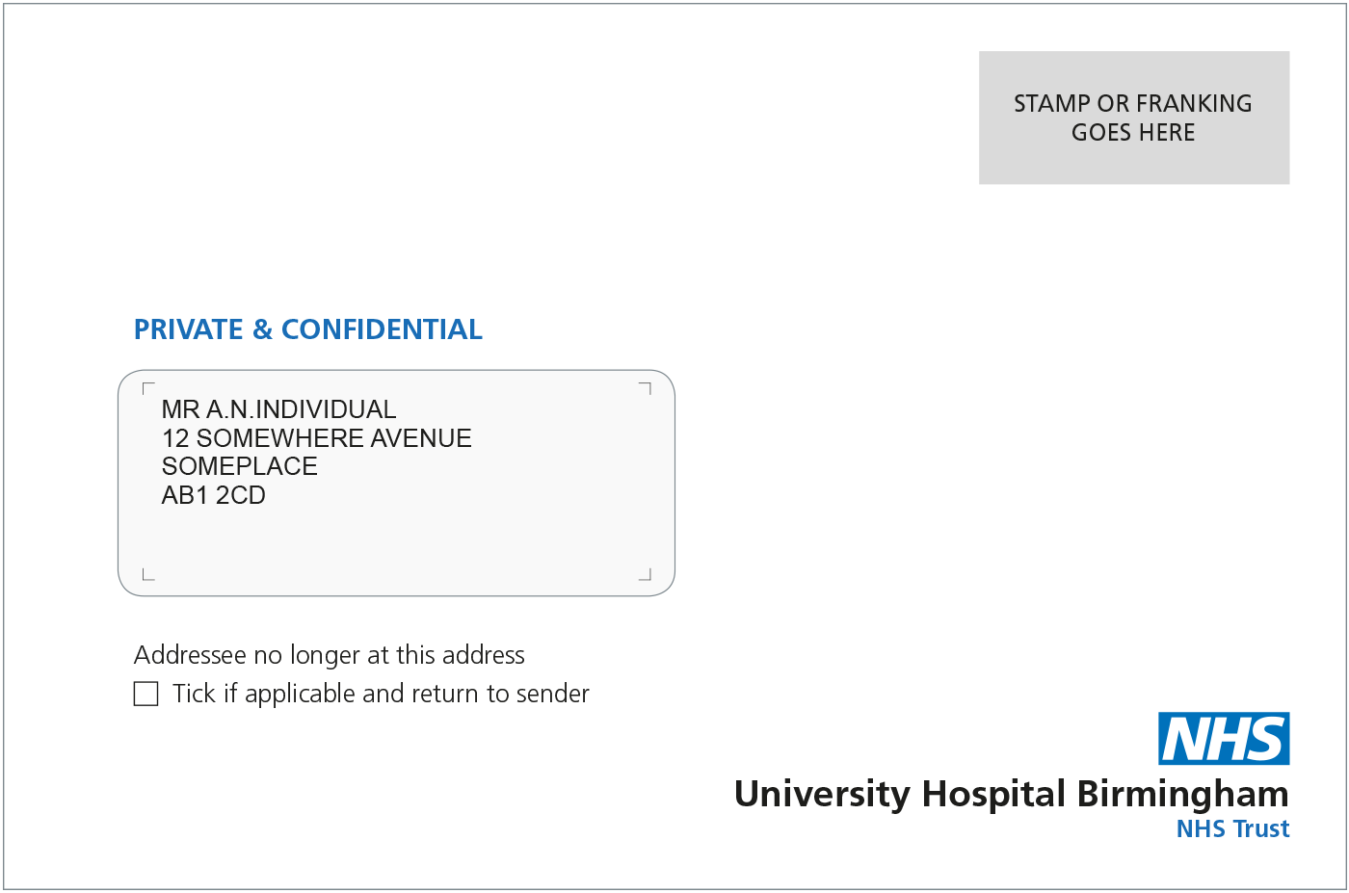
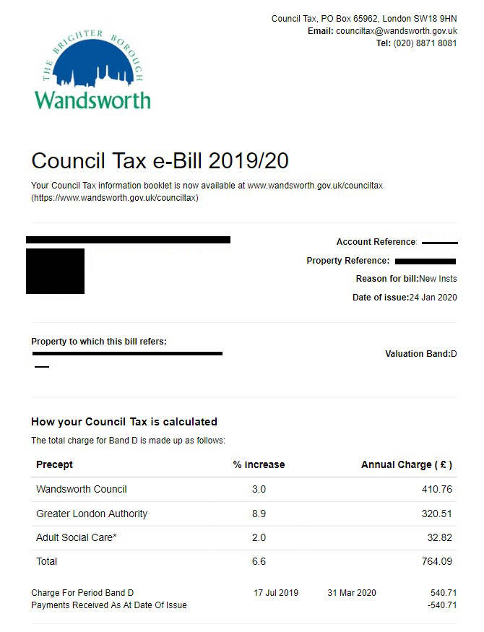
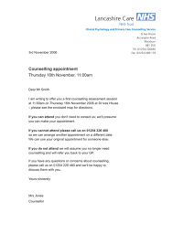
WE HAD NEVER researched THESE HUMBLE PIECES OF MAIL
Even though JICMAIL data tells us that 100% of this type of mail is engaged with by citizens
Our research told us that consumers don’t think of this mail any differently than any other mail, we found the term customer mail chimed the best
Interviews with Government Comms teams understood how we alighted on this term for it
Essentially we boiled customer mail down to anything that:
Supports an existing relationship that you have with an organization or institution
Seeks to achieve citizen focused objectives including compliance, a change in behavior or building trust
To get people to stop doing something or change their behaviour or to get them to take action on something they need to
We’d never looked at customer mail before. It was time.

Slide 8
Two years ago we decided to explore mail’s role in citizen experience
Do people think mail influences the relationships they have with Government institutions?
If so, what does mail offer to CX?
How mail and digital can work together in CX?
Notes:
This template was inserted from Power-user, the productivity add-in for PowerPoint, Excel and Word.
Install Power-user to access thousands of templates, icons, maps, diagrams and charts with Power-user.
Visit https://www.powerusersoftwares.com/
©Power-user SAS, terms of license: https://www.powerusersoftwares.com/terms

Slide 9
TO DISCOVER IT’S IMPACT ON CITIZENS
Citizen expectations and behaviours have changed
Covid has changed forever the landscape in both good and bad ways
Trust isn’t high in the state to deliver what’s needed
Over reliance on digital may erode that trust
Notes:
This template was inserted from Power-user, the productivity add-in for PowerPoint, Excel and Word.
Install Power-user to access thousands of templates, icons, maps, diagrams and charts with Power-user.
Visit https://www.powerusersoftwares.com/
©Power-user SAS, terms of license: https://www.powerusersoftwares.com/terms

Slide 10
To understand why Required a major research vision
Six-part research task conducted by award-winning research agency Trinity McQueen including in-depth interviews and co-creation workshops
Marketreach worked in collaboration with Accenture for CX insight and expertise
How does mail add value to CX?
How can mail be implemented optimally as part of a full CX?
24 consumer observational interviews
Quantitative consumer survey: 6,300 online and offline interviews
18 decision maker depth interviews to explore response to key findings and messages
21 in-depth interviews with top mail decision makers in Financial Services, Retail, Government and Energy/ Telco
4 co-creation workshops to develop best practice messaging
Customer in-home interviews to confirm mail usage and language
Notes:
This template was inserted from Power-user, the productivity add-in for PowerPoint, Excel and Word.
Install Power-user to access thousands of templates, icons, maps, diagrams and charts with Power-user.
Visit https://www.powerusersoftwares.com/
©Power-user SAS, terms of license: https://www.powerusersoftwares.com/terms

Slide 11
JICMAIL’s diary panel confirms Customer mail’s impact FOR GOVERNMENT
100%
83%
70%
46%
Engaged with – opened, read, sorted, put aside, put on display, put in usual place
Opened
Read, looked,
glanced at
Filed for
reference
Source: JICMAIL, Business Mail, Government/Local Government, n=6,932, 2022

Slide 12
customer mail and cx
The findings

Slide 13
CUSTOMER MAIL RECEIVES MORE ATTENTION AND ENGAGEMENT THAN EQUIVALENT DIGITAL MESSAGING
SENDING CUSTOMER MAIL SIGNIFIES IMPORTANCE

Slide 14
PEOPLE POSITIVELY ENGAGE WITH CUSTOMER MAIL MORE THAN EMAIL
Mail vs. emails – All, most or about half of them (%)
% positive engagement
% positive engagement
% positive engagement
Local Government
DWP & HMRC
NHS Appointment
Source: Royial Mail, Trinity McQueen, 2022

Slide 15
Mail is retained
Appointments are more likely to be put on display as a reminder
Source: Royial Mail, Trinity McQueen, 2022

Slide 16
Mail signifies importance at twice the levels of digital
Applies more to customer mail than digital
Source: Royial Mail, Trinity McQueen, All sectors, 2022
Notes:
All

Slide 17
Mail Preferred but works alongside other channels
In combination citizens like more than one channel, letter first, text to remind
“
I like the fact that my next appointment is given to me with a printout then followed up with a text to remind me that my appointment is due
Male, 56
“
Source: Royial Mail, Trinity McQueen, 2022

Slide 18
Citizens value the mail they receive
It’s useful, clear, trusted – a powerful tool in behaviour change
Source: Royial Mail, Trinity McQueen, 2022

Slide 19
Mail signifies importance
And because it is important people read it and feel more confident with the content
Source: Royial Mail, Trinity McQueen, 2022

Slide 20
And for the NHS
Source: Royial Mail, Trinity McQueen, 2022

Slide 21
And for local Government
Source: Royial Mail, Trinity McQueen, 2022

Slide 22
Mail makes customers feel recognised
Making it critical to a CX plan
48%
Q: Sending mail shows an organization cares about reaching all its customers
Agree (Disagree)
18-34’s | 58% (15%)
35-54’s | 42% (20%)
55’s+ | 46% (19%)
(18% disagree)
Source: Royial Mail, Trinity McQueen, Combined sectors, 2022

Slide 23
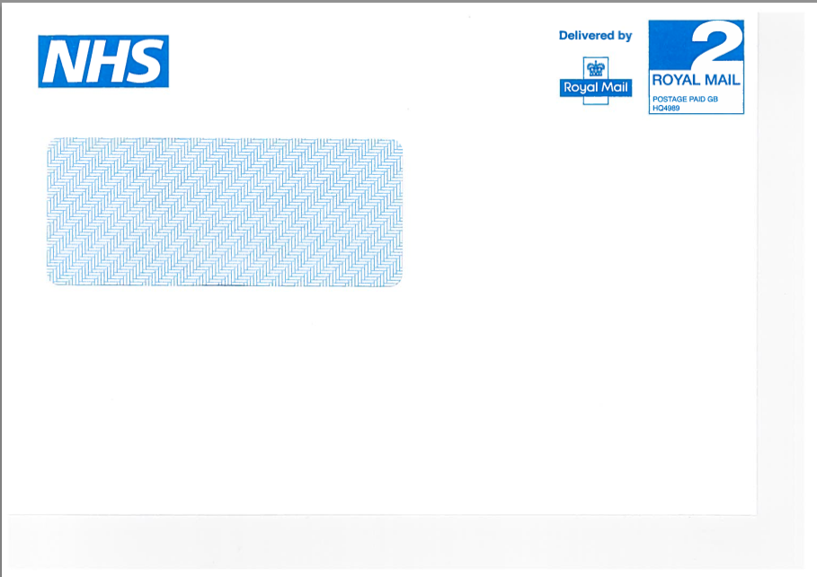
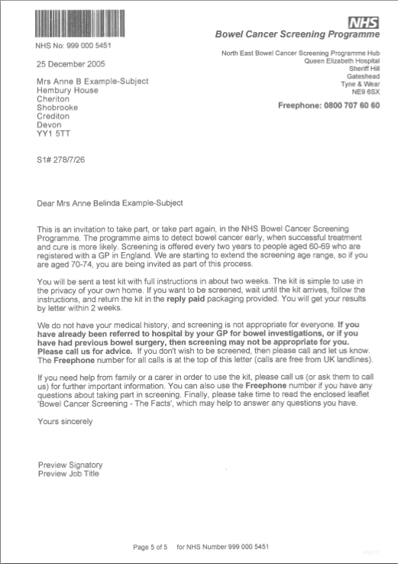
With hospital appointments scoring highest on trust
Completely trust the mail I receive Agree or agree strongly (%)
Source: Royial Mail, Trinity McQueen, 2022

Slide 24
Mail is more trusted than digital
Feels private and secure
I would think it might be a scam
12%
33%
33%
Same
48%
Same
50%
17%
Source: Royial Mail, Trinity McQueen, Combined sectors, 2022

Slide 25
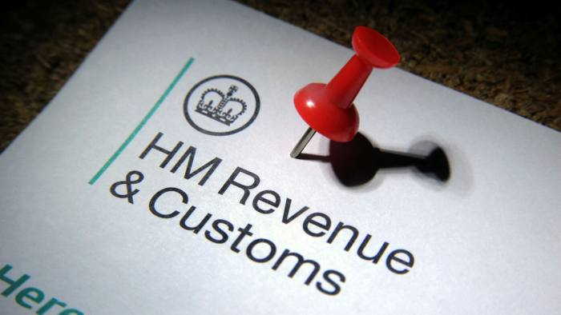
Trust comes from feeling recognised and valued
Shows the sender has taken time and care with the communication
Applies more to mail or digital (%)
Makes me feel valued
33%
26%
56%
61%
Same
Same
11%
12%
Source: Royial Mail, Trinity McQueen, Combined sectors, 2022

Slide 26
mail helps clarify complex information and is easier to read than digital
Applies more to mail or digital (%)
A good way to help me understand complex information
31%
53%
About the same
16%
Source: Royial Mail, Trinity McQueen, Combined sectors, 2022

Slide 27
The Mail and digital partnership - phygital
Mail boosts memory response
Mail and digital communications are different and complementary
Each situation needs to be considered on its own merit – Physical can reinforce digital and vice versa
Multi-channel experiences are more effective - working together, they can make messages stronger and more likely to be remembered
Mail has a powerful impact on long-term memory encoding for social media advertising = +44% stronger when people had seen mail first
A reading of 0.70 and above indicates a response that is likely to be powerful enough to impact future behaviour
0.72
STRENGTH OF BRAIN RESPONSE
0.50
SOCIAL MEDIA ADVERTISING SEEN BEFORE MAIL
SOCIAL MEDIA ADVERTISING SEEN AFTER MAIL
LONG TERM MEMORY ENCODING
https://www.marketreach.co.uk/sites/default/files/insights/Mail-Cuts-Through-Report.pdf)

Slide 28
even in a digital world
Agree (Disagree)
56%
68%
(10%)
(14%)
I need to keep paper docs as proof of address/ identity
Keeping paper records is the right thing to do
(15%)
56%
54%
(17%)
These findings apply equally across all age groups
Mail helps me to manage my financial affairs
Mail makes me feel more organised
Source: Royial Mail, Trinity McQueen, Combined sectors, 2022
Notes:
We saw this a lot as well in the qual research, consumers reports having clear filing approaches as they know they will want to put their hands on it.
For some it is a highly organised filing system, for others it is a messy pile or a box under their bed, but most report having a place where the keep mail they deem important so they can have it available when they need it
We see this for all age groups. The variation is that older audiences will have more brand relationships they need to track – bank accounts, mortgages, medical forms, home bills…

Slide 29
Younger age groups also engage with mail more than email
Mail vs. emails – All, most or about half of them (%)
Positive engagement
NET of any of these
77
67
Among
18-34’s
NET of any of these
1 in 3 seek physical tangibility
Source: Royial Mail, Trinity McQueen, Combined sectors, 2022

Slide 30
Paper’s sustainability is a strong message in today’s environmentally focussed world
Belief in statements about the environmental impact of mail communications
% Believe vs. disbelieve
77%
15%
65%
24%
55%
29%
Paper is one of the most recycled products in the world
Paper is a renewable and sustainable product
The wood used to make paper is grown and harvested in a carefully controlled and sustainable way
Source: Royial Mail, Trinity McQueen, Combined sectors, 2022

Slide 31
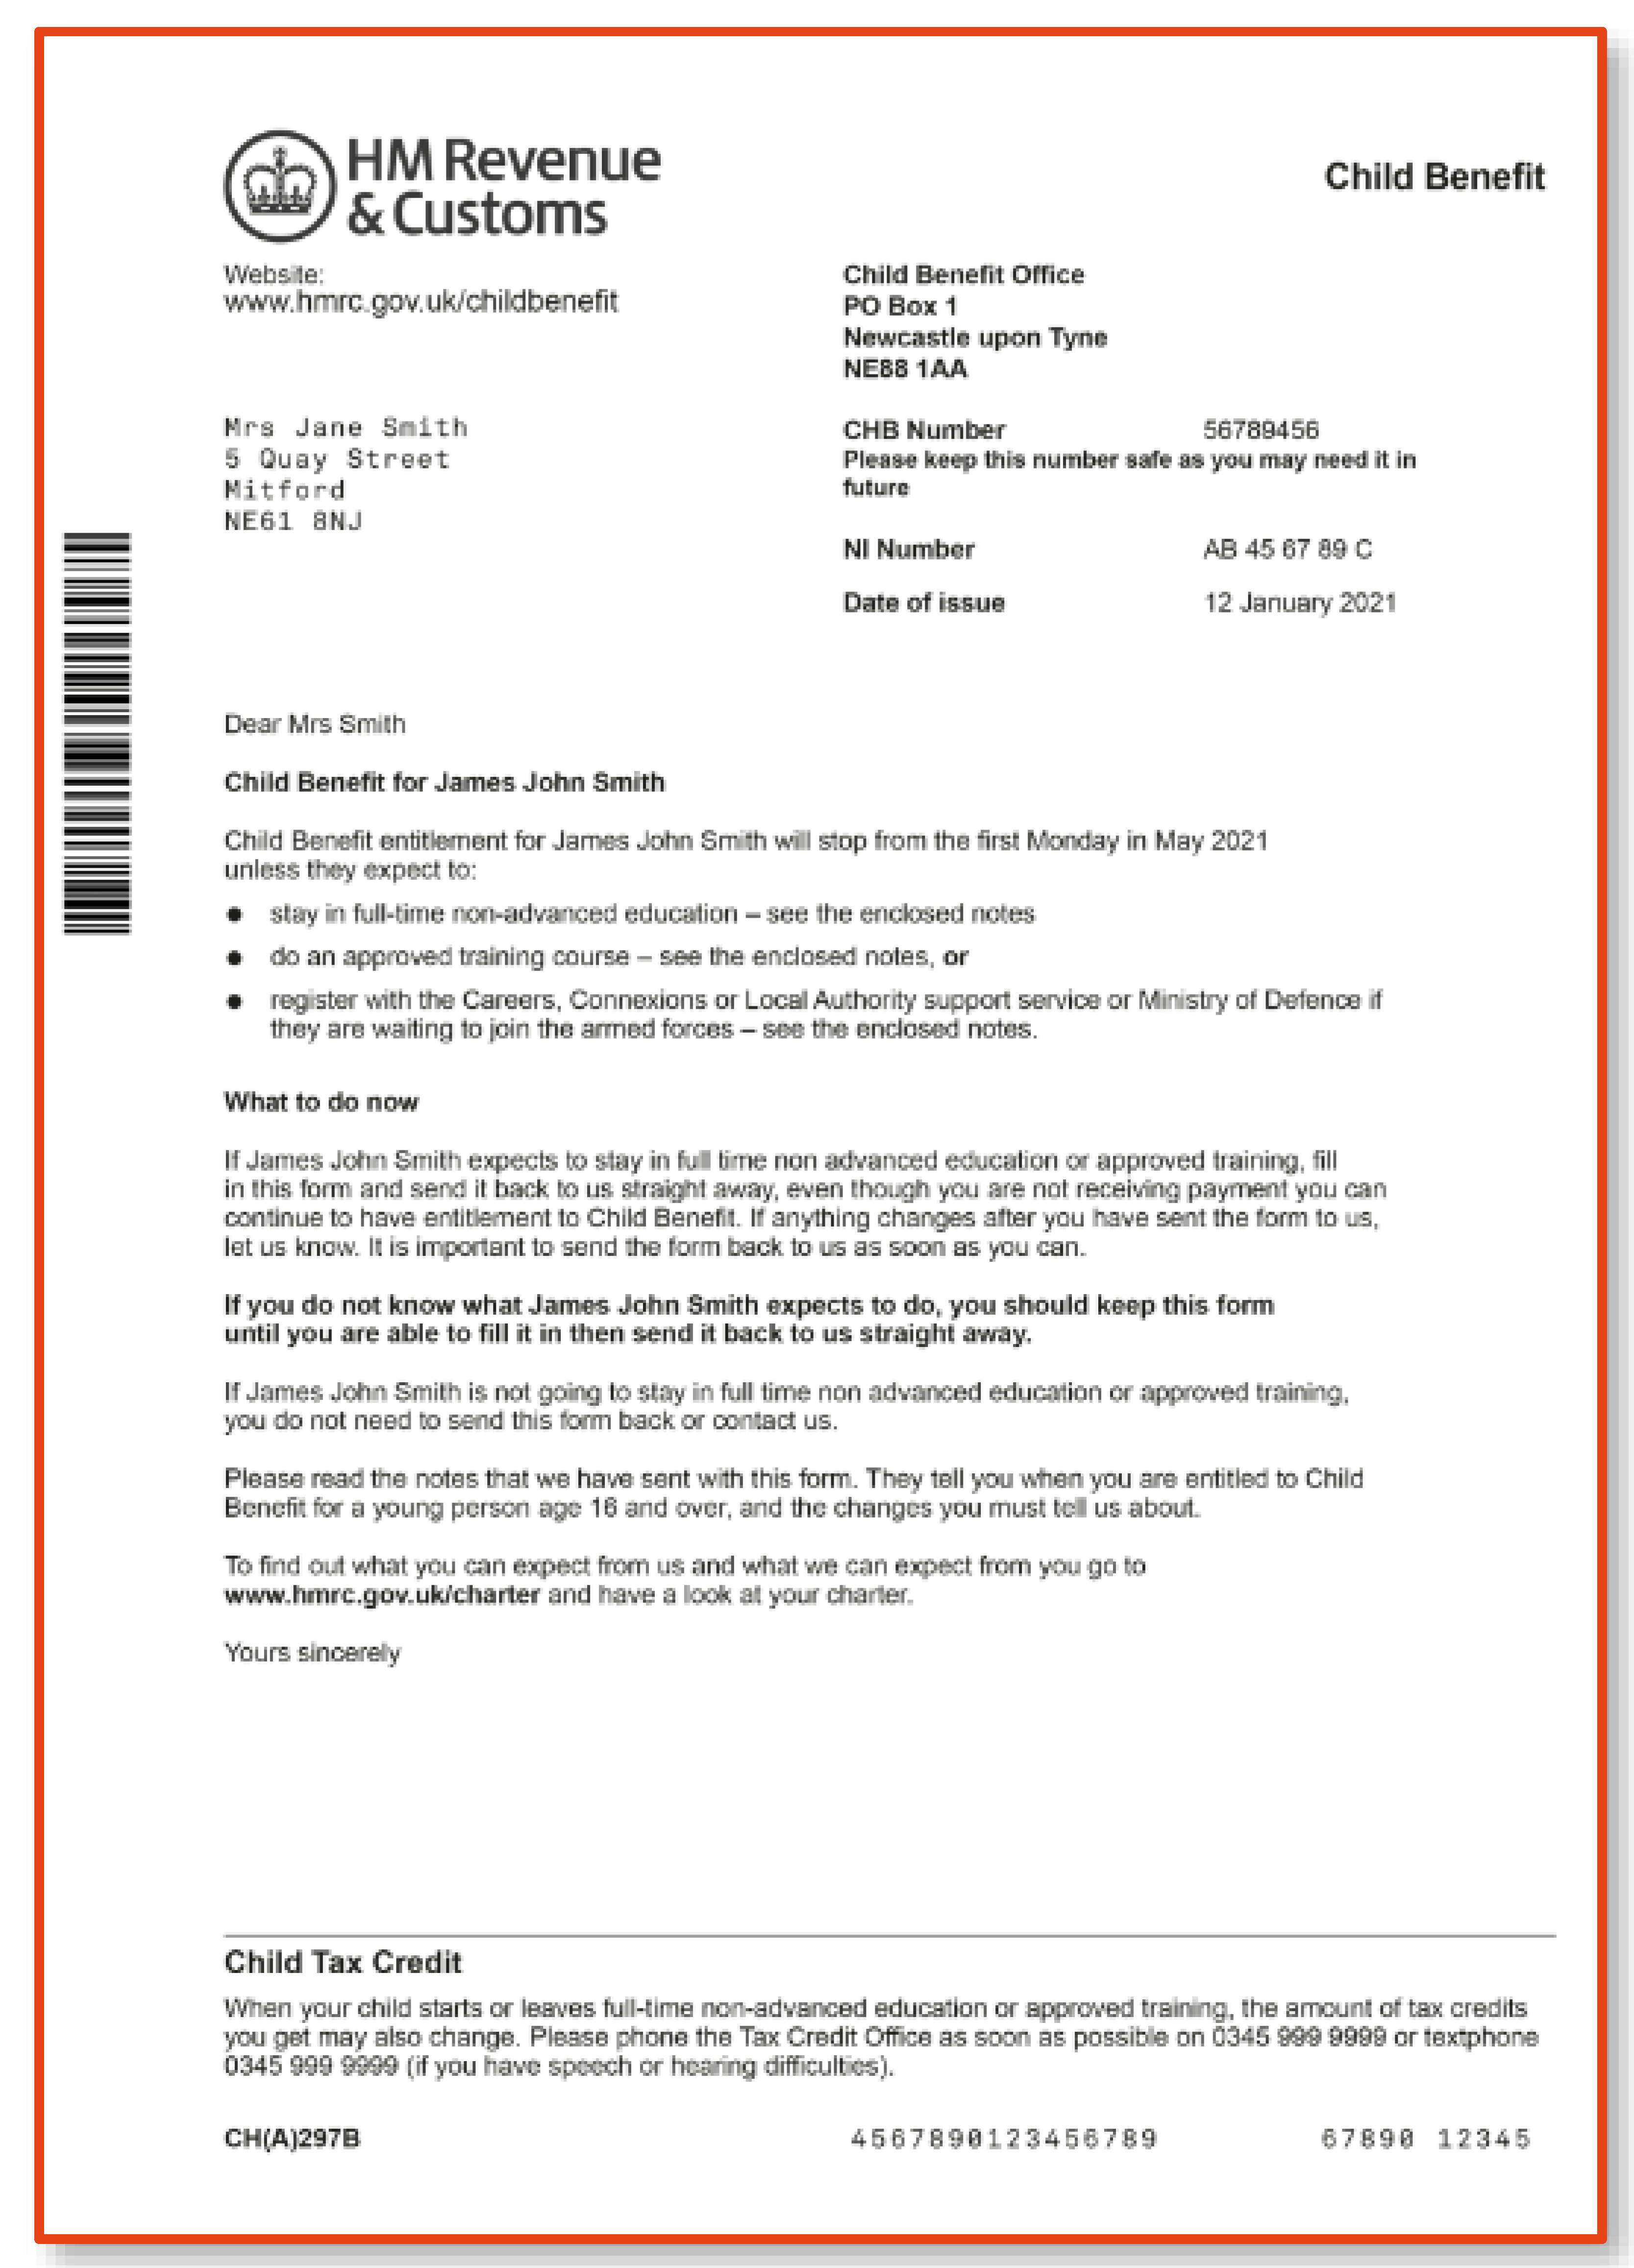
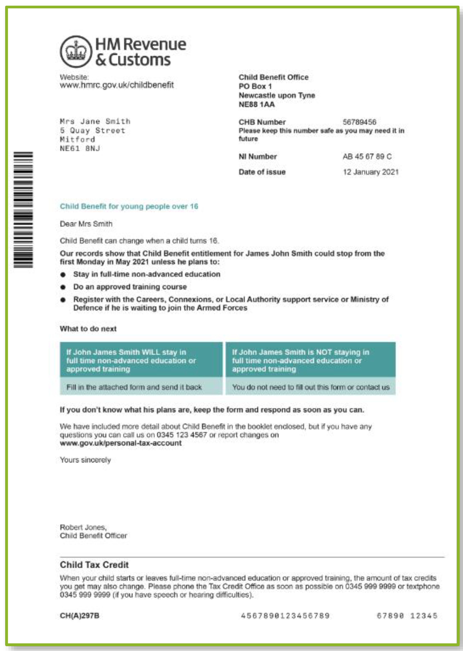
Difference between poor and good practice
Use of colour
Clearer visual hierarchy (e.g. most important information in a larger font or bold)
Table visualising required next steps
Includes a telephone number in the sign-off paragraph
Named sender (Robert Jones)
52
58
Clear what I’m being asked to do
39
51
Looks easy to read
POOR
GOOD
Source: Royial Mail, Trinity McQueen, HMRC, 2022

Slide 32
Use it because you should not because you could
Customer mail is not for everything, all the time
It is best deployed when it can address some its key strengths
Customers want to remain in control of how they interact with organisations, they want to choose how they are communicated with
Preferences are individual and context dependent, but most agree that mail should be used for important communications

Slide 33
Any organisation that cares about trust should use mail
Mail means important
Trust
Mail and digital are not the same
Best practice matters
Phygital
Measure
Customer mail gets more attention and engagement than equivalent digital. It speaks to people 121
Trust is the bedrock of great CX. Mail is valued for its clarity, helpfulness and relevance
They are complementary and distinct. People want both and expect brands to respect them by using all channels and using them well
Understand what makes mail work and do it well.
People recognise and engage with mail’s sustainability
People expect organisations to use the tools they have the best way they can. They want what’s best in physical and digital
The way to prove value and learn is to measure – test mail versus email and measure calls to the call centre as a start

Slide 34
THANK YOU – QUESTIONS PLEASE!

Slide 35
Design matters. we defined best practice design, copy and content guidelines
Ensure branding and tone is in line with other (e.g. marketing) communications to reinforce
Provide a range of contact / response options
Include unnecessary and irrelevant information (risks overshadowing main message)
Keep copy / information minimal – short and succinct more likely to be read (ideally one page)
Use in combination with other channels for maximum impact (serves as reminder to take action)
Use overly complex language and information
Signpost key information to maximise ease of reading and comprehension
Use personalisation where possible (first names, personal info etc.) to maximise impact
Cram wording/lines, or use small font
Sign off from a named individual to humanise the message
Keep letters visually interesting; use tables, bullets and bolding to ease comprehension
Strongly encourage a switch to digital, instead give customer a choice of channel
Customer mail should be treated with the same care and attention as every other brand touchpoint
Notes:
People undermine their brand by forgetting mail, they spend loads on website etc. but then don’t translate it to mail.
Branding needs to reflect the brand in mail.
QR Code are valued as a good way to guide people to content – as long as they are used to continue the journey – the QR code has to take you to somewhere useful, not just the web home page
Multiple channels are valued – send me a letter about my appointment and then send me an email to remind me. They appreciate this as good communication and engagement.
Personalise where you can.
Explain why things are changing - why costs are going up and why bills are increasing. Don’t just deliver this news, explain it – and show why staying a customer is still a benefit
Don’t include anything unnecessary, create the right balance of words for the message

Slide 36
MAIL HELPS SAVE LIVES THROUGH BOWEL CANCER SCREENING
Background:
Early detection of bowel cancer saves lives. The North East Bowel Cancer Screening Programme Hub is one of 5 hubs in England that is tasked with getting over 60s to participate in screening.
Solution:
In a rolling programme, The North East Bowel Cancer Screening Programme Hub invite all eligible over 60-year-olds to participate in screening. Every element of the programme is mailed: the initial invitation letter, the follow-up test kit, the results (positive or negative) and the reminder mailing for non-participants.
Email penetration and acceptance is lower amongst over 60’s, so mail guarantees that the invitation and test kit will reach everyone. And the physical presence of the letter and kit in the home act as a prompt to participate.
Results:
The minimum uptake target in the programme nationally is 52 %– through the use of mail - North East Bowel Cancer Screening Programme Hub consistently hits that target. (an uptake of 57.48% was achieved in 2015-16).
Source: Philip Kelly, Manager, North East Bowel Cancer Screening Programme Hub

Slide 37
National bowel cancer screening
Impressing the over 60s
Background
Early detection of bowel cancer saves lives. The North East Bowel Cancer Screening Programme Hub is one of 5 hubs in England that is tasked with getting over 60s to participate in screening.
Solution
Email penetration and acceptance amongst the over 60s is low. The Programme Hub instead looked to Business Mail – a channel with a physical presence that remains in the home, and acts as a prompt to participate.
They created a full rolling programme where every element – from invitation to follow-up test, to results, to reminders – is sent through the mail.
Results
The programme has enabled the North East Bowel Cancer Screening Programme to consistently hit their target of a 52% uptake in screenings.
Source: Philip Kelly, Manager, North East Bowel Cancer Screening Programme Hub

Slide 38
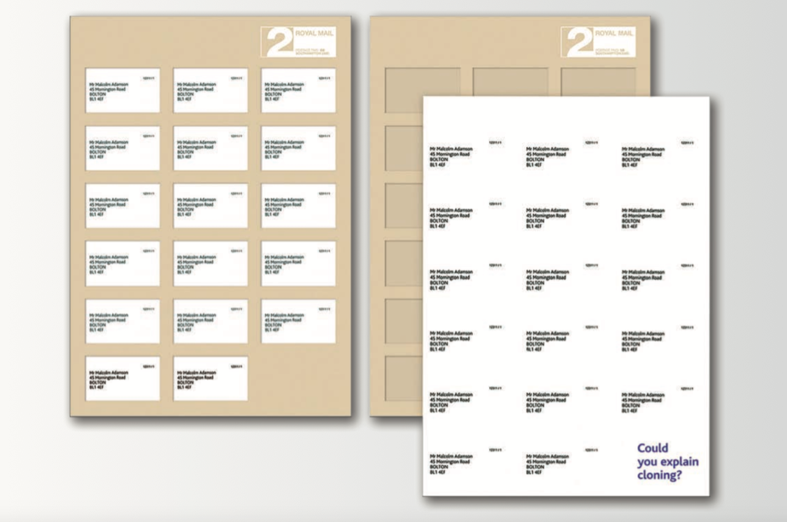
A mailing about cloning cloned new science teachers
Background
Training & Development Agency needed to lure the limited number of Physics and Chemistry graduates away from the corporate world into teacher training as a career.
Solution
Recent Physics and Chemistry graduates were sent a mailing that had their name and address repeated again and again on the envelope. Inside was the question: ‘Could you explain cloning? To a group of unique individuals? Without repeating yourself?’’
A science teacher case study reinforced how rewarding it can be to work with inquiring minds.
Results
The campaign delivered a 4.8% application-conversion rate.
Source: Canada Post

